Slide 1



College
2025
Event
Portal
Presented by
ByteCoders
Next Slide

Slide 2








ByteCoders
2025
RSVP System
The RSVP system helps students easily let organizers know if they’re coming to an event or not.
We just get a link or form and choose “Yes,” “No,” or “Maybe.”
All the responses are saved automatically, so organizers know how many people to expect.
It really helps in planning things like food, seating, and event setup smoothly.

Slide 3



Audience
ByteCoders
2025
Use Case
A student opens the portal, browses upcoming events by type, and RSVPs to a technical workshop in one click. After attending, they submit feedback and later use the issue reporting section to request their certificate. All steps happen quickly and easily from a single web app
Feasibility
Fully browser
-based (no install, low maintenance, supports single-link sharing).
Ready for campus-wide deployment or future migration to a more robust cloud/server solution.
Can be easily extended to add other college needs or analytics in future.

Slide 4


ByteCoders
2025
Listing Events
Technical
Workshop
Seminar
Hackathaon
Cultural
Motor Fest
Trade Expo
Sports Evens

Slide 5



USER
View
ByteCoders
2025
Users Say
Want single portal for all college events. Registrastion should be easier not long filling forms.
50
Series 1
Series 2
Series 3
40
User Think
30
Will show only relevant events. Secure the users informations. What if the plan changes.
20
10
0
Item 1
Item 2
Item 3
Item 4
Item 5

Slide 6




ByteCoders
What we
Added
2025
Showcase the event’s gallery. Easly view the event calander
Personal dashboard
Cancellation within 48 hours with refund Feedback after events
Added card payment method

Slide 7
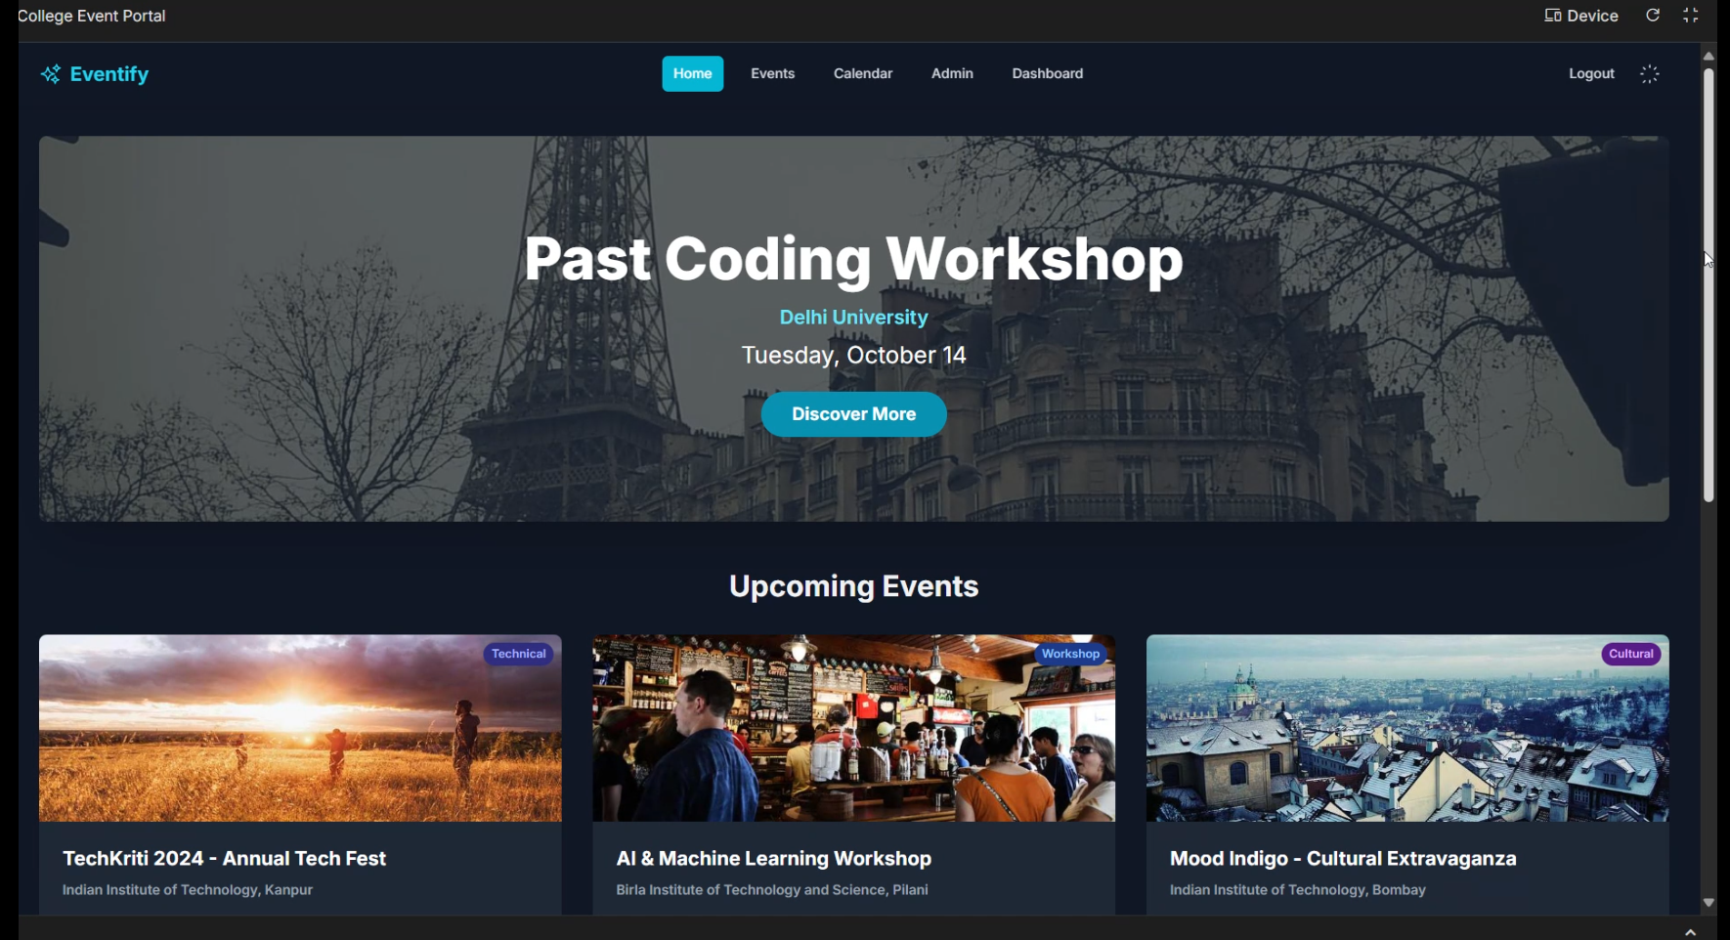
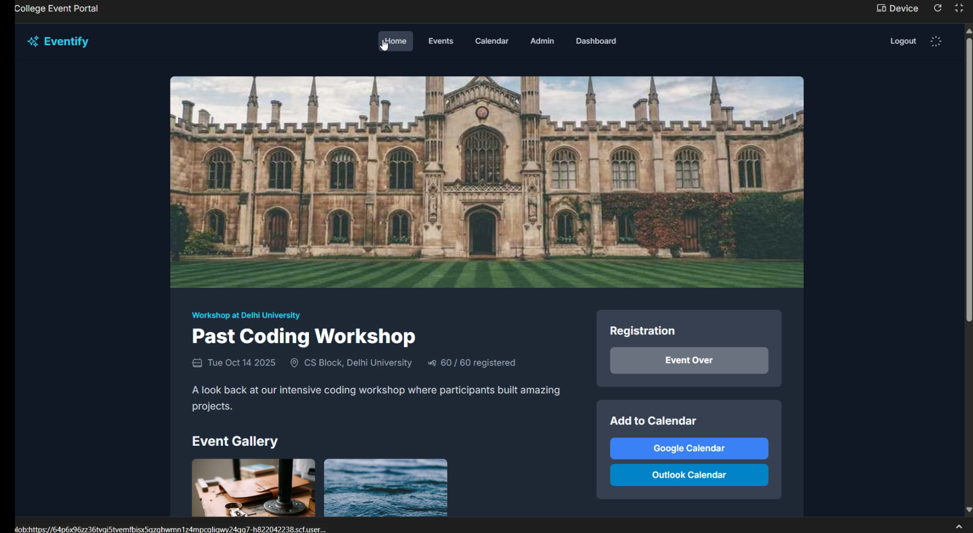
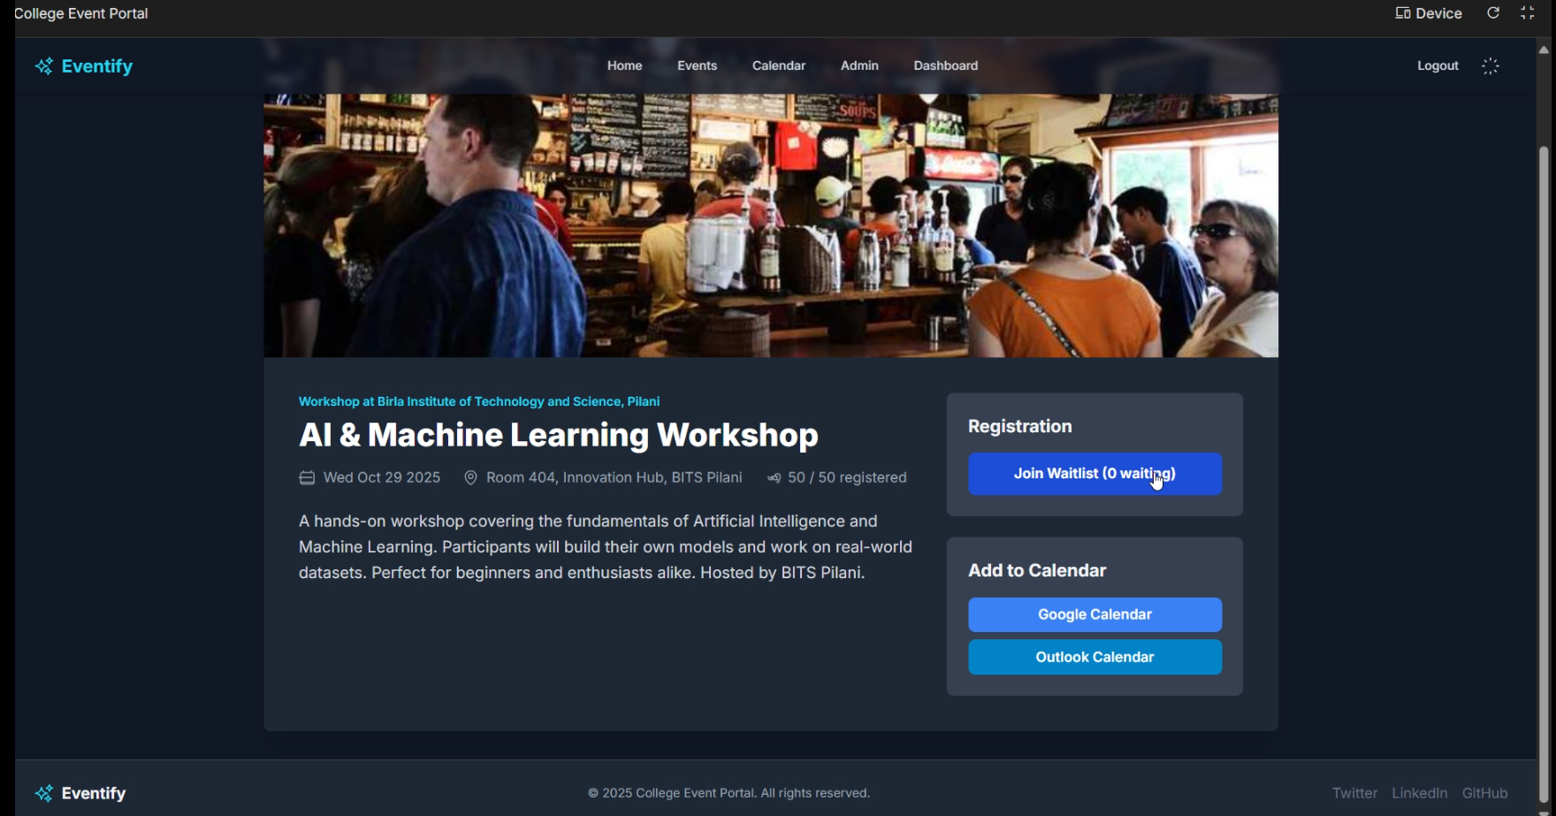
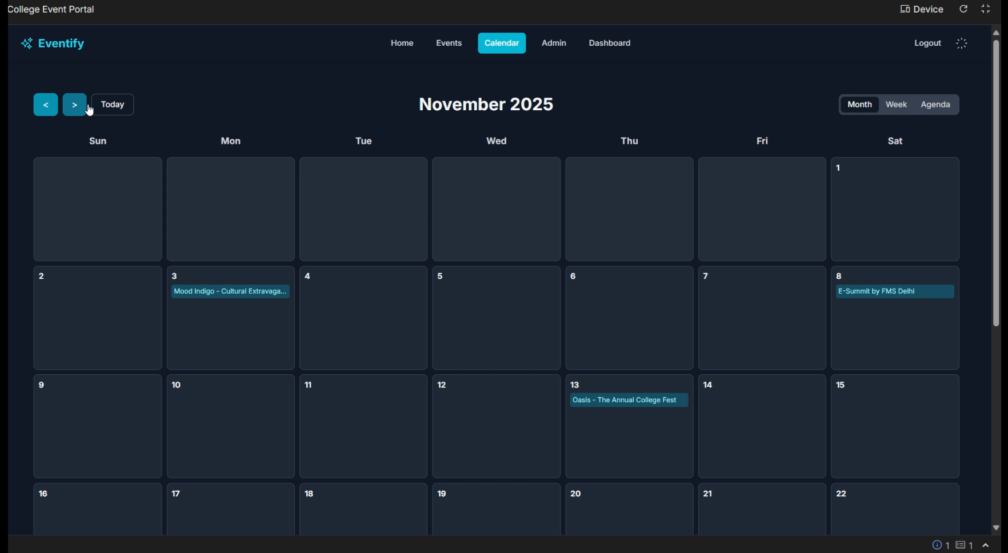
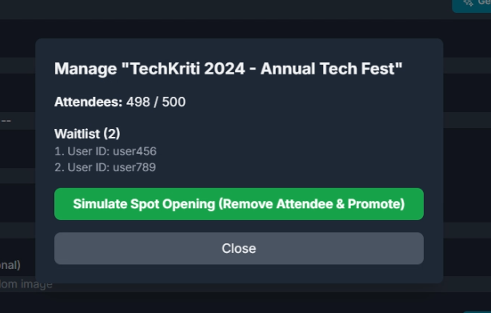
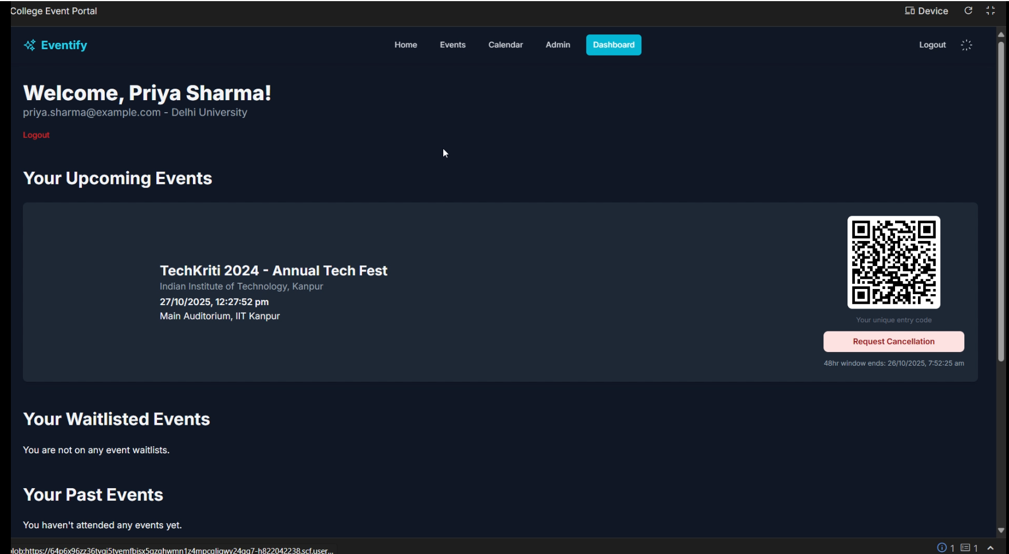
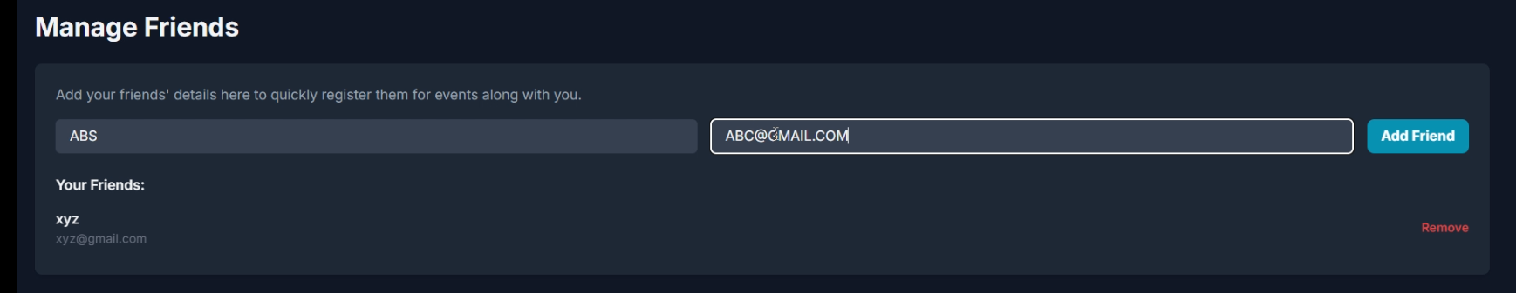

Slide 8


ByteCoders
2025
ThankYou!

